Slide 1
SpaceX Project Fatih ÖZGÜL 18.04.2023

Slide 2


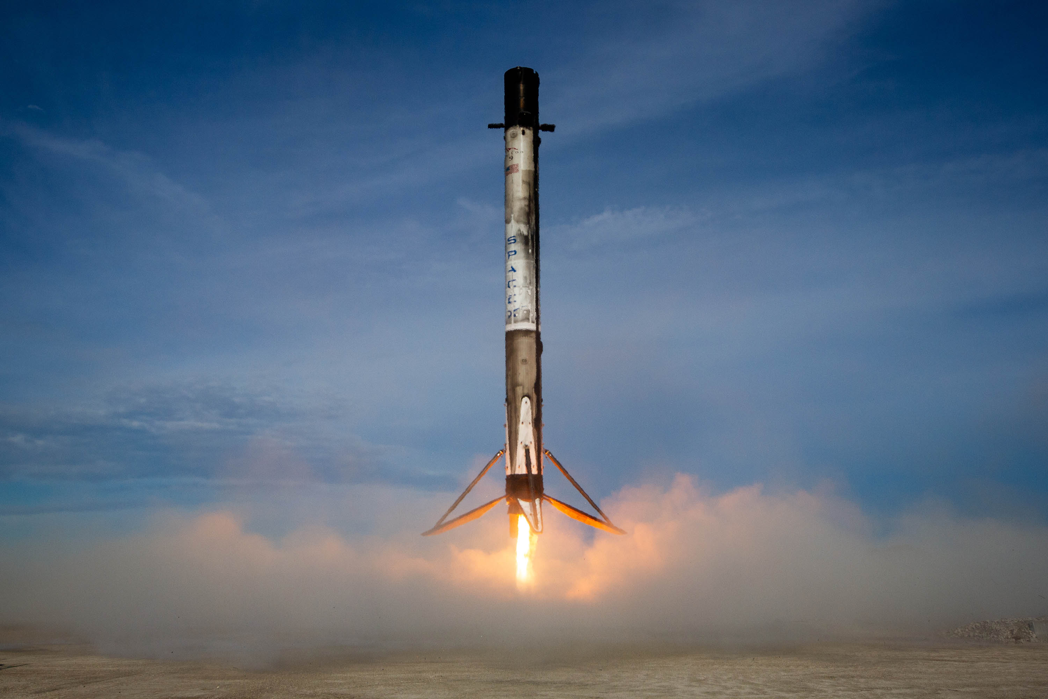
•
•
•
•
•
•

Slide 3
Summary of methodologies
Summary of all results
Data collection
Data wrangling
EDA with Data Visualization
EDA with SQL
Building an interactive map with Folium
Building a Dashboard with Plotly Dash
Predictive analysis (Classification)
EDA results
Interactive analytics demo in screenshots
Predictive analysis results

Slide 4

SpaceX is the leading company in commercial space travel, as they have made it more affordable. They offer the Falcon 9 rocket launch on their website for 62 million dollars, which is significantly cheaper than other providers whose prices start at 165 million dollars each. This is because SpaceX is able to reuse the first stage of their rockets. Therefore, by determining whether or not the first stage will land successfully, we can predict the cost of a launch. Using publicly available information and machine learning models, we aim to predict whether SpaceX will be able to reuse the first stage of their rocket.
At this point, some questions come to mind:
In what ways do factors like payload mass, launch location, number of flights, and orbits impact the success rate of the first stage landing?
Is there an upward trend in the success rate over time?
Additionally, which algorithm would be most effective for binary classification in this scenario?

Slide 5

Data collection methodology:
Using SpaceX Rest API
Using Web Scrapping from Wikipedia
Performed data wrangling
Filtering the data
Dealing with missing values
Using One Hot Encoding to prepare the data to a binary classification
Performed exploratory data analysis (EDA) using visualization and SQL
Performed interactive visual analytics using Folium and Plotly Dash
Performed predictive analysis using classification models
Building, tuning and evaluation of classification models to ensure the best results

Slide 6


Slide 7

To gather comprehensive information for a detailed analysis of SpaceX launches, we utilized two methods of data collection: retrieving data through API requests from SpaceX REST API, and extracting information from a table on SpaceX's Wikipedia page by web scraping. Both methods were necessary to ensure that we had all the data we needed.
Data Columns are obtained by using SpaceX REST API:
FlightNumber, Date, BoosterVersion, PayloadMass, Orbit, LaunchSite, Outcome, Flights, GridFins, Reused, Legs, LandingPad, Block, ReusedCount, Serial, Longitude, Latitude
Data Columns are obtained by using Wikipedia Web Scraping:
Flight No., Launch site, Payload, PayloadMass, Orbit, Customer, Launch outcome, Version Booster, Booster landing, Date, Time

Slide 8
To convert the response content into a DF, you can decode it using the .json() and then transform it into a flattened DF format using the .json_normalize().
Requesting needed information about the launches from SpaceX API by applying custom functions
Requesting rocket launch data from SpaceX API
Constructing data we have obtained into a dictionary
Replacing missing values of Payload Mass column with mean()
Filtering the dataframe to only include Falcon 9 launches
Exporting the data to CSV
Creating a DF from the dictionary

Slide 9
Requesting Falcon 9 launch data from Wikipedia
Creating a BeautifulSoup object from the HTML response
Extracting
all column names from the HTML table header
Collecting the data by parsing
HTML tables
Constructing data we have obtained into a dictionary
Creating a DF from the dictionary
Exporting the data to CSV

Slide 10

The dataset contains various instances of the booster failing to land correctly. Some landings were attempted but resulted in accidents, such as "True Ocean," indicating a successful landing in a specific area of the ocean, and "False Ocean," indicating an unsuccessful landing in the ocean. Similarly, "True RTLS" denotes a successful landing on a ground pad, while "False RTLS" indicates an unsuccessful landing on a ground pad. "True ASDS" indicates a successful landing on a drone ship, while "False ASDS" indicates an unsuccessful landing on a drone ship. To create training labels from these outcomes, a "1" is assigned for a successful landing and a "0" for an unsuccessful one.
Perform EDA and determine Training Labels
Calculate the # of launches on each site
Calculate the number and occurrence of each orbit
Calculate the number and occurrence of mission outcome per orbit type
Create a landing outcome label from Outcome column
Exporting the data to CSV

Slide 11
Charts were plotted:
-Flight Number vs. Payload Mass,
-Flight Number vs. Launch Site,
-Payload Mass vs. Launch Site,
-Orbit Type vs. Success Rate,
-Flight Number vs. Orbit Type,
-Payload Mass vs Orbit Type and
-Success Rate Yearly Trend
Scatter plots show the relationship between variables. If a relationship exists, they could be used in machine learning model. Bar charts show comparisons among discrete categories. The goal is to show the relationship between the specific categories being compared and a measured value. Line charts show trends in data over time (time series).

Slide 12

Performed SQL queries:
Displaying the names of the unique launch sites in the space mission
Displaying 5 records where launch sites begin with the string ‘CCA'
Displaying the total payload mass carried by boosters launched by NASA (CRS)
Displaying average payload mass carried by booster version F9 v1.1
Listing the date when the first successful landing outcome in ground pad was achieved
Listing the names of the boosters which have success in drone ship and have payload mass greater than 4000 but less than 6000
Listing the total number of successful and failure mission outcomes
Listing the names of the booster versions which have carried the maximum payload mass
Listing the failed landing outcomes in drone ship, their booster versions and launch site names for the months in year 2015
Ranking the count of landing outcomes (such as Failure (drone ship) or Success (ground pad)) between the date 2010-06-04 and 2017-03-20 in descending order

Slide 13
Markers of all Launch Sites:
The task involved adding markers with circles, popup labels, and text labels to display the NASA Johnson Space Center's location based on its latitude and longitude coordinates. Additionally, markers with circles, popup labels, and text labels were added to all launch sites to indicate their geographical positions and proximity to the Equator and coasts.
Coloured Markers of the launch outcomes for each Launch Site:
The statement is referring to the addition of colored markers, specifically green for successful launches and red for failed launches, using a Marker Cluster. This addition is intended to help identify which launch sites have a relatively higher success rate.
Distances between a Launch Site to its proximities:
To illustrate the distance between the launch site KSC LC-39A and nearby locations such as the railway, highway, coastline, and closest city, colored lines have been included.

Slide 14
Launch Sites Dropdown List: Added a dropdown list to enable Launch Site selection.
Pie Chart showing Success Launches (All Sites/Certain Site): Added a pie chart to show the total successful launches count for all sites and the Success vs. Failed counts for the site, if a specific Launch Site was selected.
Slider of Payload Mass Range: Added a slider to select Payload range
Scatter Chart of Payload Mass vs. Success Rate for the diﬀerent Booster Versions: Added a scatter chart to show the correlation between Payload and Launch Success.

Slide 15
Standardizing the data with StandardScaler, then fitting and transforming it
Splitting the data into training and testing sets with train_test_split function
Creating a GridSearchCV object with cv = 10 to find the best parameters
Creating a NumPy array from the column “Class” in data
Finding the method performs best by examining the Jaccard_score and F1_score metrics
Calculating the accuracy on the test data using the method .score() for all models
Applying GridSearchCV on LogReg, SVM, Decision Tree, and KNN models
Examining the confusion matrix for all models

Slide 16

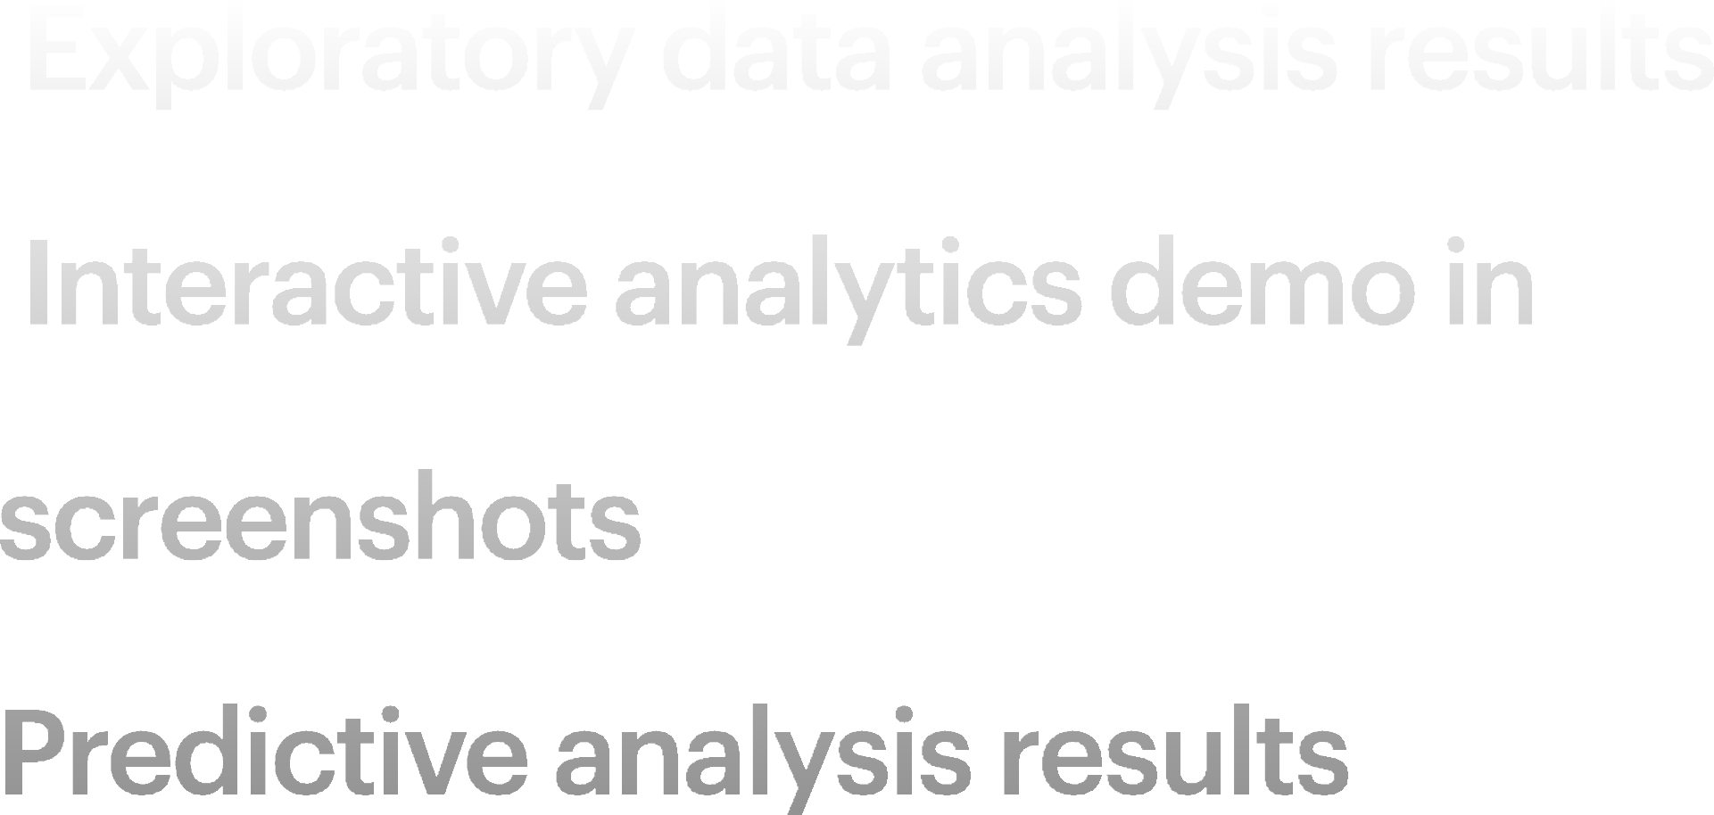
•
•
•

Slide 18
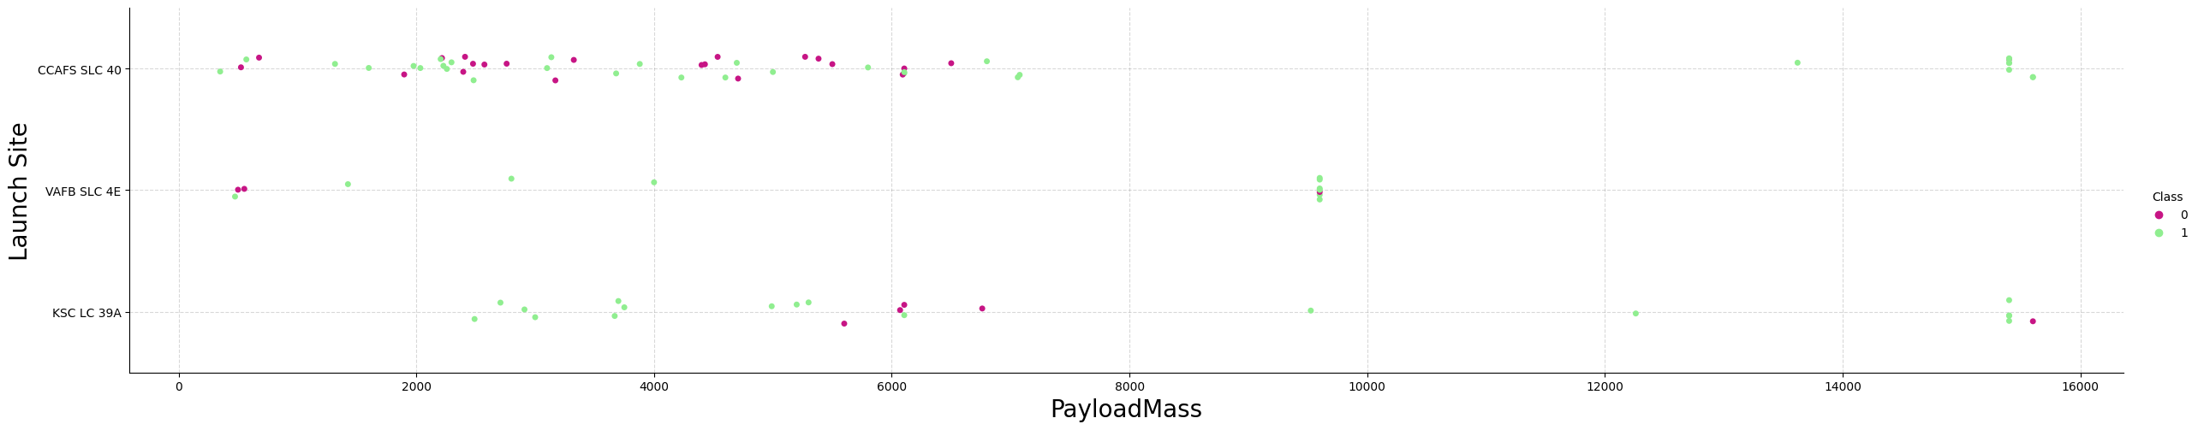
Explanation: The success rate of a launch site increases with the payload mass, and launches with a payload mass greater than 7000 kg were mostly successful. Additionally, KSC LC 39A has a 100% success rate for payload masses under 5500 kg.

Slide 19

Explanation:
Orbits with 100% success rate:
ES-L1, GEO, HEO, SSO
Orbits with 0% success rate:
SO
Orbits with success rate between 50% and 85%:
GTO, ISS, LEO, MEO, PO

Slide 20
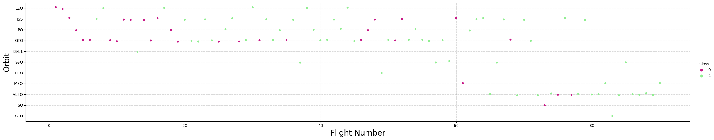
Explanation: The number of successful flights in a Low Earth Orbit (LEO) appears to be dependent on the number of flights conducted, whereas there is no correlation between the number of flights and the rate of success in a Geostationary Transfer Orbit (GTO).

Slide 21
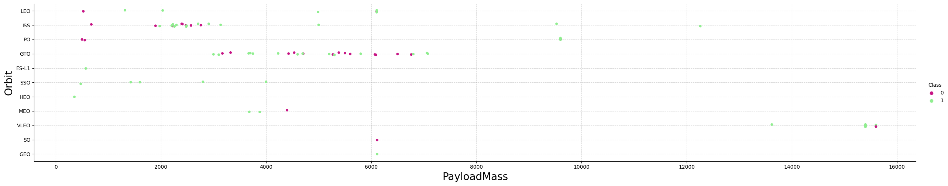
Explanation: Large payloads have a detrimental effect on geostationary transfer orbit (GTO) trajectories but a beneficial effect on GTO and polar low Earth orbit (LEO) trajectories, such as those of the International Space Station (ISS).

Slide 22
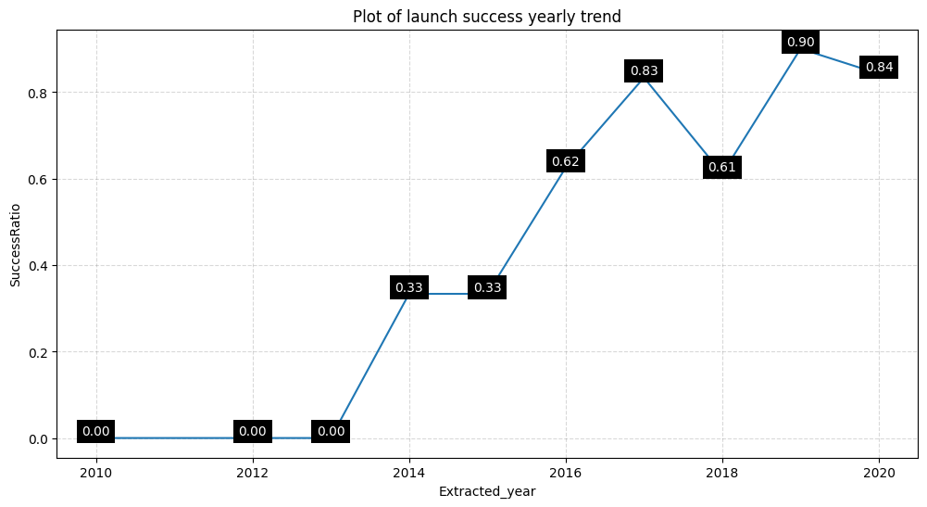
Explanation:
The success rate since 2013 kept increasing till 2020.

Slide 23


Slide 24
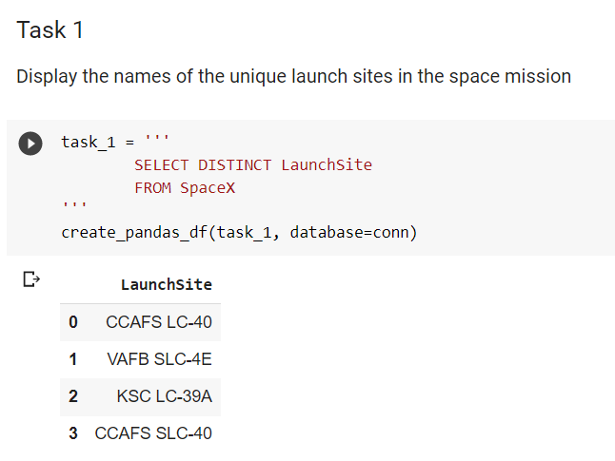
Explanation: Displaying the names of the unique launch sites in the space mission.

Slide 25
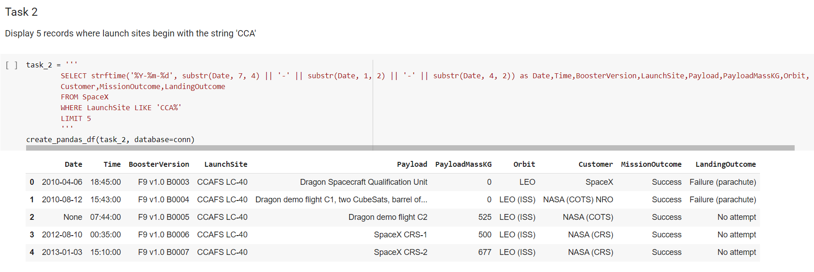
Explanation:Displaying 5 records where launch sites begin with the string 'CCA'.

Slide 26

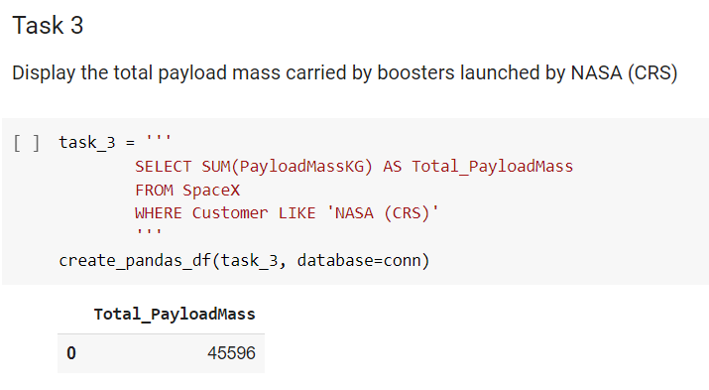
Explanation: Displaying the total payload mass carried by boosters launched by NASA (CRS).

Slide 27
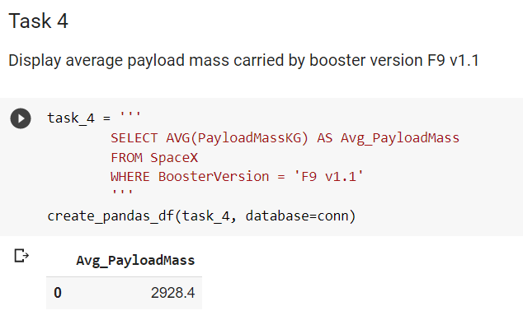
Explanation:Displaying average payload mass carried by booster version F9 v1.1.

Slide 28
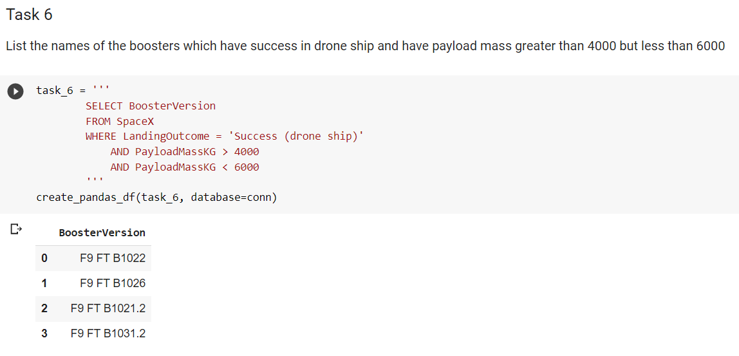
Explanation: Listing the names of the boosters which have success in drone ship and have payload mass greater than 4000 but less than 6000.

Slide 29

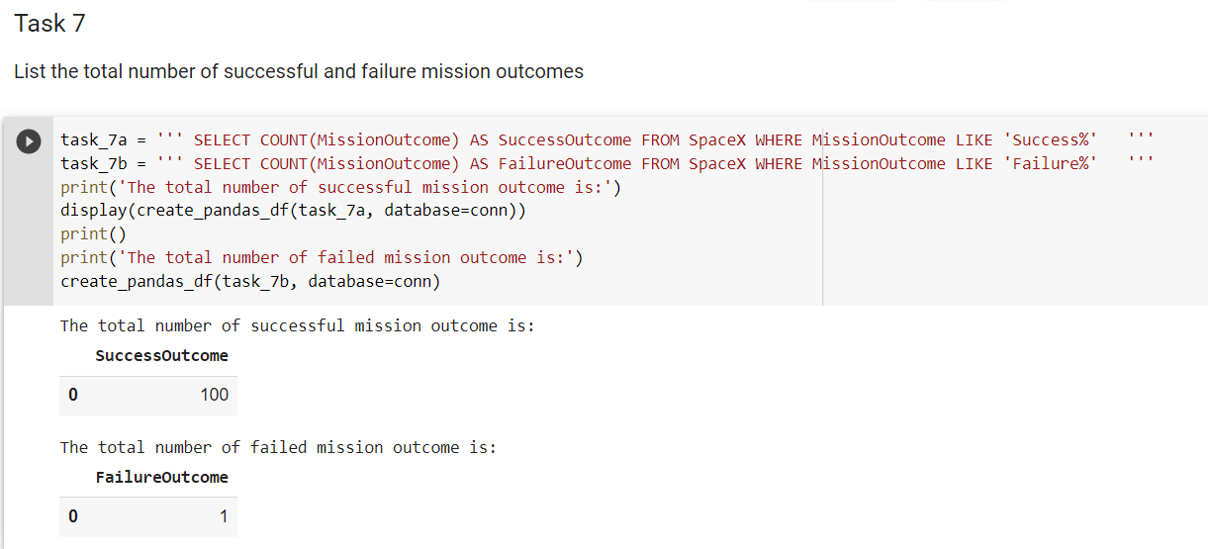
Explanation: Listing the total number of successful and failure mission outcomes.

Slide 30
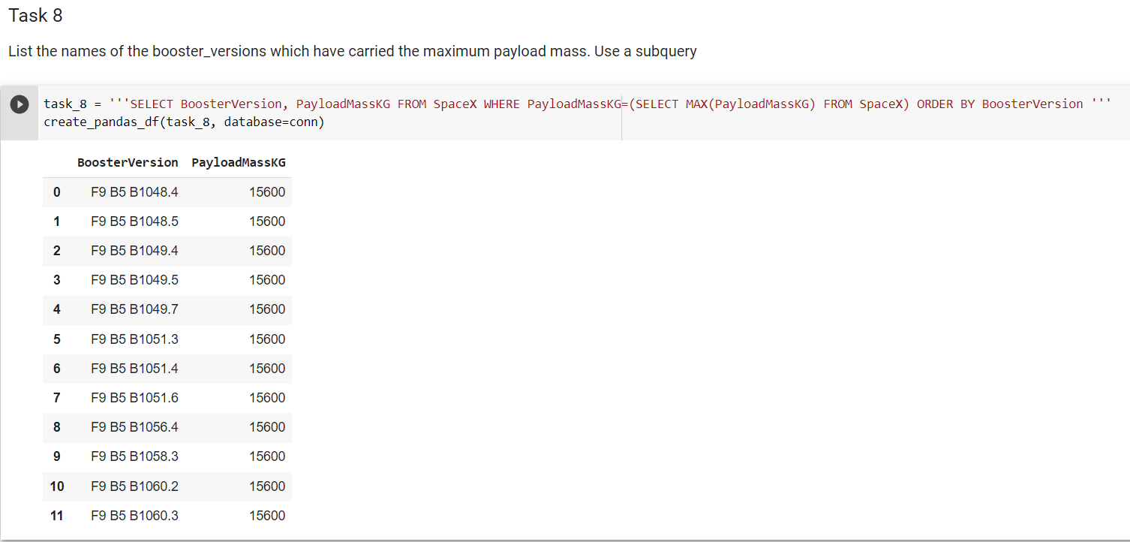
Explanation: Listing the names of the booster versions which have carried the maximum payload mass.

Slide 31
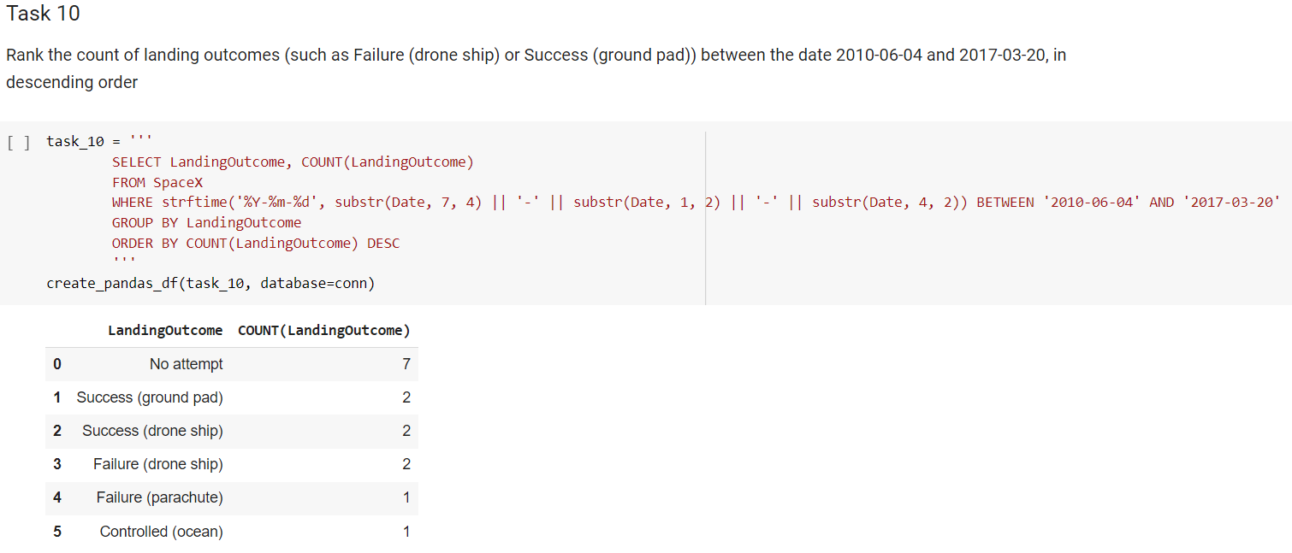
Explanation: Reorder the frequency of landing results (such as unsuccessful landing on a drone ship or successful landing on a ground pad) from June 4th, 2010 to March 20th, 2017, starting with the most frequent outcome and ending with the least frequent outcome.

Slide 33
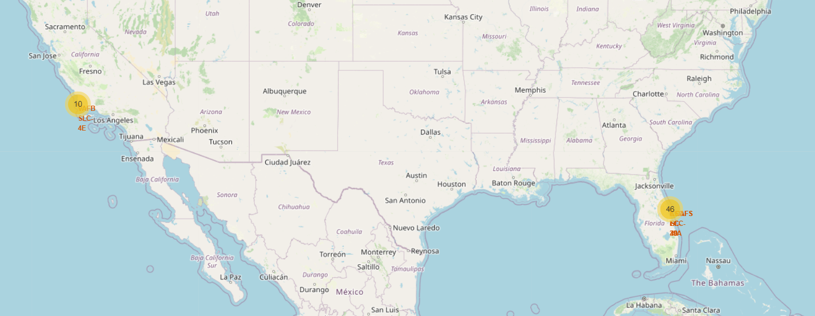
Explanation: Most of Launch sites are in proximity to the Equator line. The land is moving faster at the equator than any other place on the surface of the Earth. Anything on the surface of the Earth at the equator is already moving at 1670 km/hour. If a ship is launched from the equator it goes up into space, and it is also moving around the Earth at the same speed it was moving before launching. This is because of inertia. This speed will help the spacecraft keep up a good enough speed to stay in orbit. All launch sites are in very close proximity to the coast, while launching rockets towards the ocean it minimises the risk of having any debris dropping or exploding near people.

Slide 34
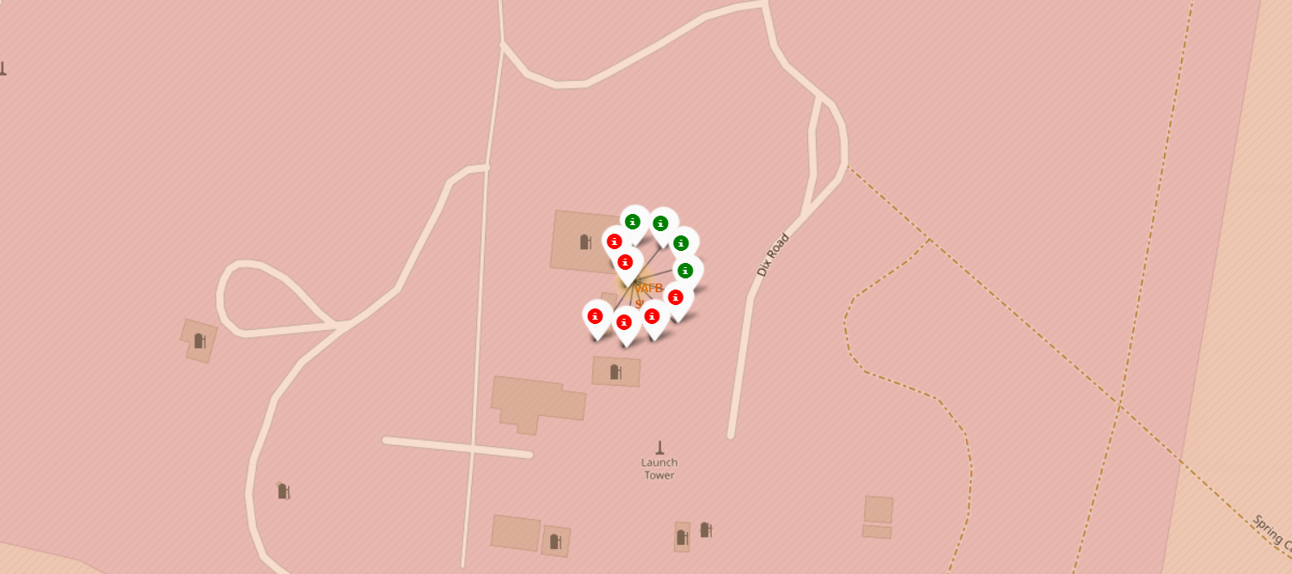
Explanation:
From the colour-labeled markers we should be able to easily identify which launch sites have relatively high success rates.
Green Marker = Successful Launch Red Marker = Failed Launch
Launch Site KSC LC-39A has a very high Success Rate.

Slide 35

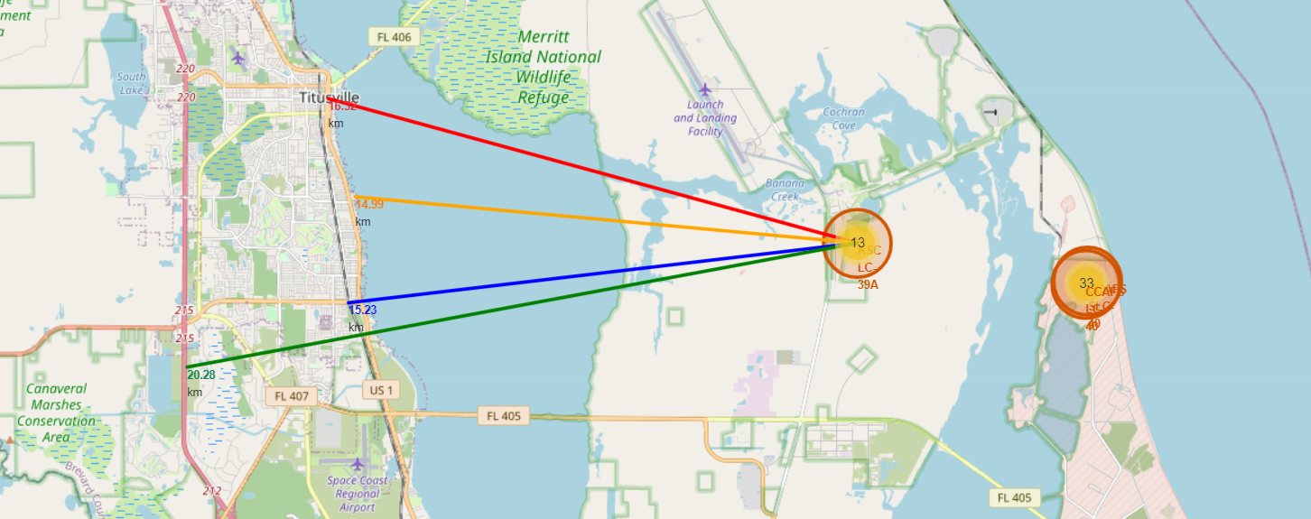
Explanation:From the visual analysis of the launch site KSC LC-39A we can clearly see that it is:
-Relative close to railway (15.23 km)
-Relative close to highway (20.28 km)
-Relative close to coastline (14.99 km)

Slide 36


Slide 37
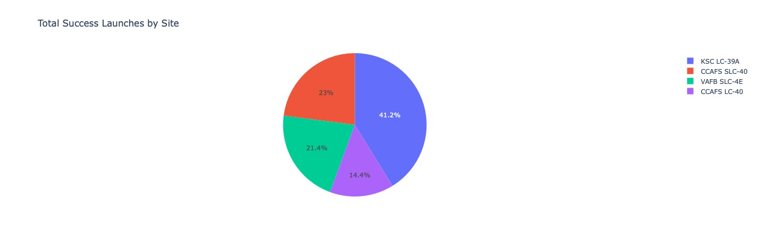
Explanation: The chart clearly shows that from all the sites, KSC LC-39A has the most successful launches.

Slide 38
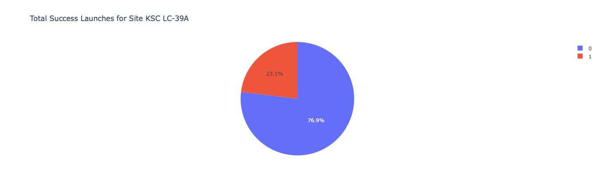
Explanation: KSC LC-39A has the highest launch success rate (76.9%) with 10 successful and only 3 failed landings.

Slide 39
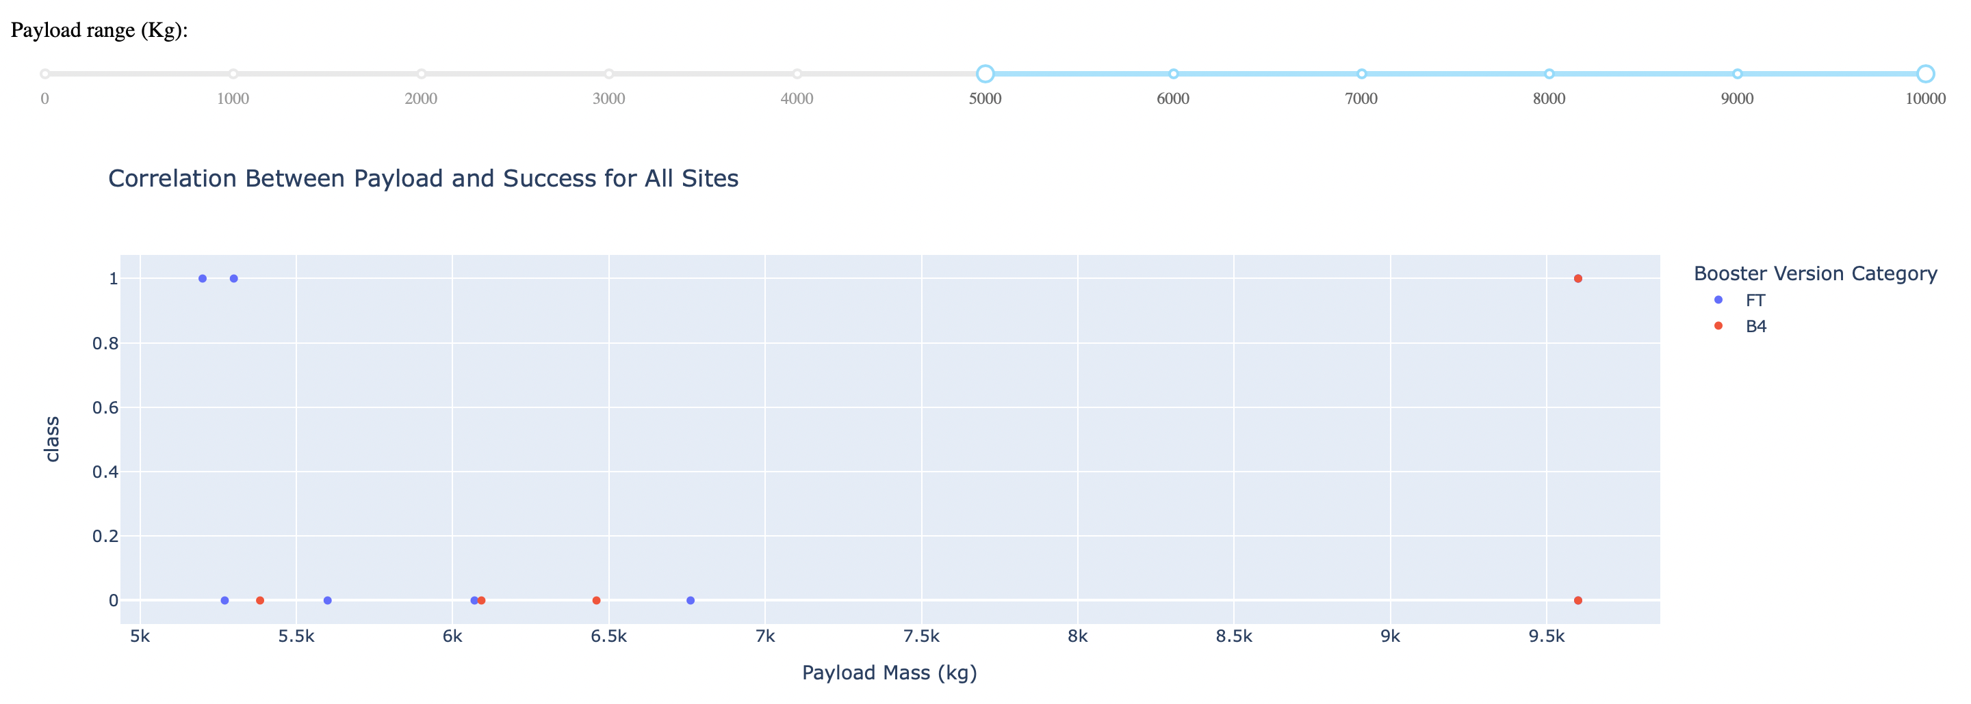
Explanation:The charts show that payloads between 2000 and 5500 kg have the highest success rate.

Slide 40


Slide 41
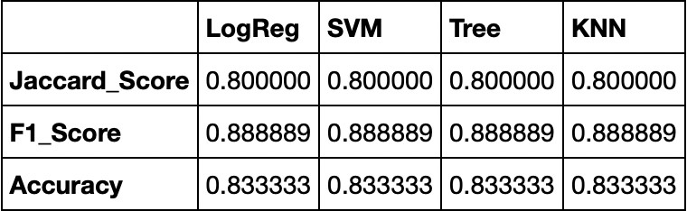
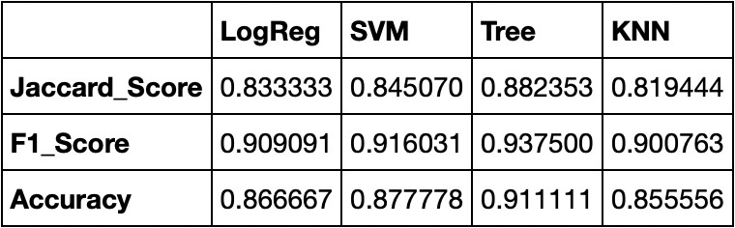
Scores and Accuracy of the Test Set
Explanation: According to the Test Set results, it is not possible to determine which method performs the best, as the scores may be influenced by the limited sample size of 18. Therefore, to further evaluate all methods, the entire Dataset was tested. The overall Dataset scores indicate that the Decision Tree Model is the most effective, as it has higher scores and the highest accuracy compared to the other models.
Scores and Accuracy of the Entire Data Set

Slide 42
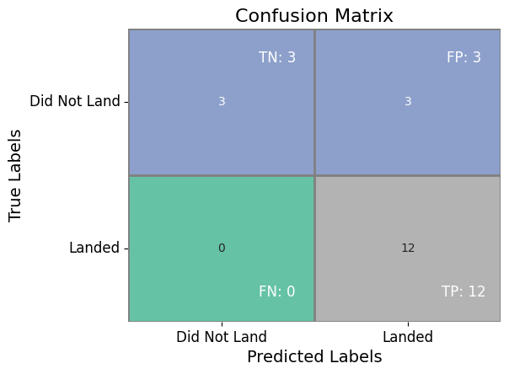
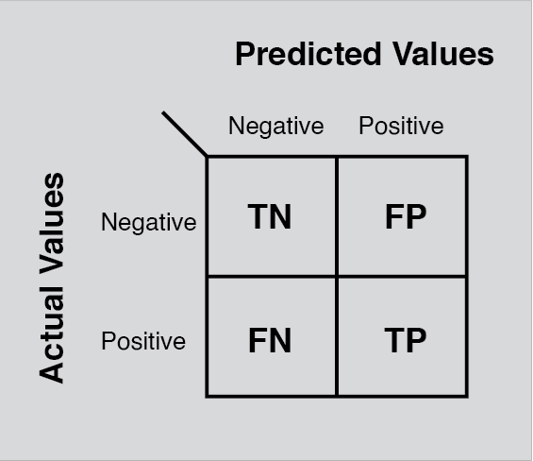
Explanation:Examining confusion matrix, we see that logistic regression can distinguish between the different classes. We see that the major problem is false positives.

Slide 43

The optimal algorithm for this dataset is the Decision Tree Model. It has been observed that launches carrying a small payload mass have a higher success rate compared to those carrying a larger payload mass. Additionally, most of the launch sites are located near the Equator and close to the coast. The success rate of launches has been observed to increase over time. KSC LC-39A has the highest success rate among all launch sites. Furthermore, all launches that have orbited ES-L1, GEO, HEO, and SSO have had a 100% success rate.

